Slide 1
Reasonable adjustments and supporting transitions
Presentation for Child and Family Alliance
22nd October 2025
Notes:
Thank you for inviting me to come and present to you today. My name is Judi Milano and I am the Inclusive Education Coordinator for Department of Education SEVR.
Prior to commencing in this role I was an Inclusion Outreach Coach, supporting schools to develop their inclusive practices with a focus on reasonable adjustments. I have worked as a special education teacher for many years and I am passionate about providing the right supports at the right time to ensure every student is successful at school.

Slide 2

Acknowledgement of Country
Acknowledgement of Country
Notes:
I respectfully acknowledge the traditional custodians of Country throughout Victoria and give my respect to Elders past and present, and to any Aboriginal or Torres Strait Islander colleagues who are here with us today.

Slide 3

What is inclusive education?
Inclusive education means that all members of every school community are valued and supported to fully participate, learn, develop and succeed within an inclusive school culture.
(Source: vic.gov.au)
Notes:
Before I start, I just wanted to go share the Department of Education’s definition of inclusive education on the left.
You might have noticed that this definition of inclusion doesn’t mention disability. It talks about ALL members of a school community. While the word ‘inclusion’ is often used as shorthand to refer to the education of students with disability, it’s important to remember that our definition of inclusion as a Department is much broader than that. Inclusive education is about everyone learning, growing and flourishing – together – in all our diversity. It embraces human diversity and welcomes all as equal members of an educational community.
A quote that sums up the notion of inclusion referring to everyone, is the one on the right from Arthur Chan. Arthur is diversity, equity and inclusion strategist from the U.S. and his quote highlights BELONGING which is a very powerful outcome of inclusive education.

Slide 4
In 2021 Department of Education rolled out the Disability Inclusion Reform. Disability Inclusion reform has 3 core goals
.
To strengthen school-wide and teaching practices, while providing tailored adjustments to support the diverse needs of students.
To deliver a more effective model of funding and support to students with a disability
To build a culture of inclusion across all schools
Notes:
In 2021 the Department rolled out the Disability Inclusion Reform
Not only is Disability Inclusion reform a new funding model, it focuses on building a culture of inclusion across all schools.
Let’s have a quick look at the aims of the Disability Inclusion Reform. There are three core goals:
Building a Culture of Inclusion: This means ensuring that every student feels valued and supported.
Improving Whole School Approaches: This is about equipping teachers with the skills and strategies they need to support every learner effectively.
Delivering Effective Funding and Support Models: This ensures that resources are allocated in a way that directly benefits those who need them most.
The reform really sets out to make sure that every student is being met at their individual point of need to ensure they can engage and participate in education and be happy at school.

Slide 5






What inclusion can look like in schools
Student Voice and Agency
Students have voice and agency present in all aspects of learning. This can include systemic gathering of student voice through student forums, Student Representative Council meetings and incorporating student voice in IEPs, SSGs and more.
See these links to Amplify and Inclusive Student Voice Toolkit
Diversity and Equity
Creating environments where all children and young people feel welcome, such as through the school taking actions to be culturally safe.
Please see the up-to-date policy template here.
Enrolment
All families are welcomed to enrol in the school of their choice within their designated neighbourhood zone.
Planning and Monitoring
An inclusive school should aim to understand the strengths, challenges and needs of students on an ongoing basis. This can be understood through IEPs, SSGs, data and ongoing monitoring.
Reasonable Adjustments
An adjustment is a measure or action taken to assist students to participate in education and training on the same basis as their peers without a disability.
Schools should think about how adjustments align with the NCCD. See this link for Disability Inclusion and NCCD Fact Sheet
Capacity Building and Upskilling
School staff are able, and are encouraged, to engage with professional learning to build capabilities in inclusive practices.
Notes:
These are just a few examples of what inclusive practices could look like in schools.
This starts at the enrolment process, and as you can see here, includes:
a strong, systemic student voice process,
through ensuring a diverse and equitable school environment,
through preparation where the school understands the strengths and needs of students on an ongoing basis,
schools engaging with reasonable adjustments and
through encouraging upskilling of staff to build their inclusive capabilities.
These are just a few examples and is not limited to these.

Slide 6
Inclusion is important for everyone
Inclusive education supports all students. A number of policies, programs and supports are available to build holistic inclusive practice in school.
Koorie Students
The Victorian Government has a strong commitment to improving Koorie education outcomes and closing the gap in educational achievement.
See here to watch the Strengthening Aboriginal Self-Determination in Education video.
See here for the Marrung: Aboriginal Education Plan.
LGBTIQ+ Students
The Victorian Government established Safe Schools and developed the LGBTIQ Student Support Policy to ensure schools are safe and inclusive for all students, including lesbian, gay, bisexual, trans and gender diverse, intersex, queer and questioning (LGBTIQ+) students, and are free of discrimination.
For more information see here.
Culturally and Linguistically diverse students (CALD)
Schools play a critical role in strengthening multicultural inclusion in our community by providing an environment where acceptance of diversity, knowledge of other cultures and an understanding of global and local issues can be developed.
For more information see here.
See here for more information here for English as an Additional Language learners
See here for additional programs available to support refugee-background students.
Students in Out of Home Care and Youth Justice
Children and young people who cannot live in their family home may access out-of-home care as a temporary, medium or long-term living arrangement. Schools are required to meet defined obligations to support the educational achievement of every child and young person in statutory out-of-home care.
For more information see here.

Slide 7
Purpose of this session:
To:
Build understanding of reasonable adjustments in schools.
Explore how adjustments support neurodiverse learners (e.g., autism, ADHD, dyslexia, sensory differences)
Equip practitioners to guide families in advocating for adjustments
Explore the effective use of Education support staff
Discuss Transition supports
Strengthen partnerships between families and schools
Notes:
So in todays session I have been asked to speak with you about Reasonable adjustments to support students to access, participate and succeed at school.

Slide 8

What are functional needs?
Functional needs are the adjustments a person requires to enable them to participate in activities on the same basis as their peers.
An adjustment is a measure or action taken to assist students to participate in education and training on the same basis as their peers without a disability.
Adjustments can be student-specific or school-wide.
For the purpose of the Disability Inclusion Profile, participation refers to involvement in activities in an educational environment.
Notes:
I'm going to break down the language used in the DI profiles a little further-
Functional needs are the adjustments a person requires to enable them to participate in activities on the same basis as their peers.
An adjustment is a measure or action taken to assist students to participate in education and training on the same basis as their peers without a disability.
Adjustments can be student-specific or school-wide.
For the purpose of the Disability Inclusion Profile, participation refers to involvement in activities in an educational environment.

Slide 9
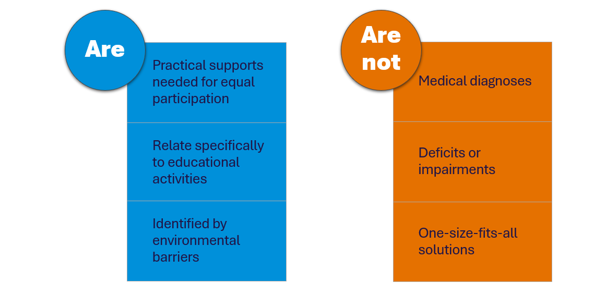
Disability Inclusion - Functional Needs
Notes:
So as previously mentioned the reform has meant that we are working with schools to reinforce the message that : - adjustments are what a person requires to participate in activities on the same basis as their peers. -relate specifically to participation in an educational setting. Adjustments are identified based on barriers within the environment e.g. accessibility or support, rather than focusing solely on a student’s disability.
Disability Inclusion is aligned with the social model of disability where the focus is on the functional needs of students rather than a focus on a diagnosis or deficit.
What Functional Needs Are Not: simply the medical or clinical conditions of a student. They are about the practical supports needed to access, participate and engage with learning.
Using a strengths based approach there is a focus on what students can do when they are provided with the right supports and adjustments rather than what they can not do

Slide 10
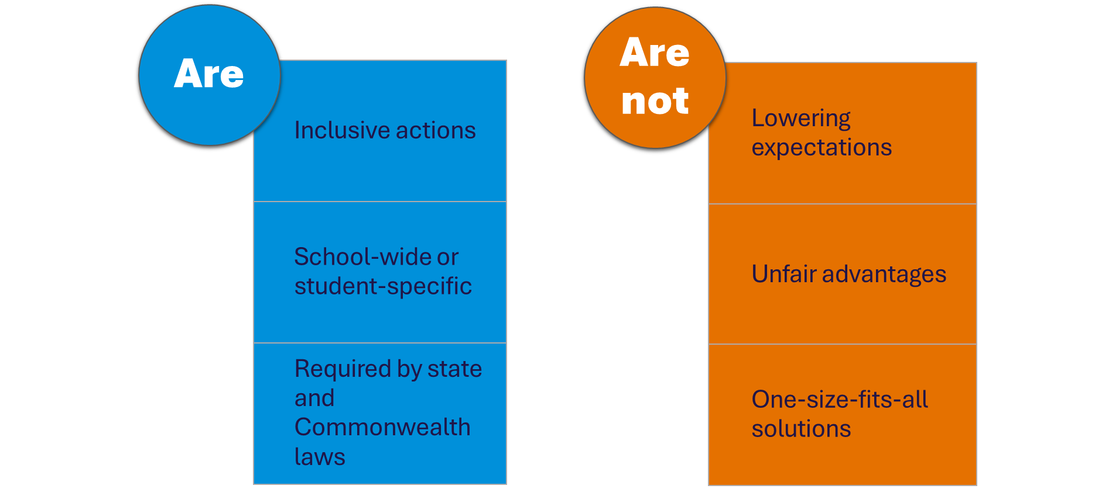
Disability Inclusion: Adjustments
Notes:
So, to summarise our messaging to schools is that adjustments are: - inclusive actions - actions taken to help students with disabilities participate in education on the same basis as their peers. - can be made in various areas, such as planning, teaching, assessment, resources, equipment, and the environment—whether in learning spaces or the yard.
They can be school-wide or student-specific: School-wide - SWPBS matrix of expectations, visual timetables in every classroom, circle time or welcome circles such as those in the Berry Street model
Student-specific - targeted intervention programs, using slant boards, wobble stools, adjustable tables and chairs, or personalised visuals
Our messaging is also that
Reasonable Accommodations/adjustments: -are required under both state and Commonwealth laws - must meet the needs of students with disabilities
Our messaging is also that adjustments Are Not: Lowering Expectations - reducing academic or behavioural expectations for students with disabilities. Special Privilege - unfair advantages; they level the playing field for all students.
One-Size-Fits-All:
Adjustments are not generic solutions applied to all students but are tailored to meet specific needs.

Slide 11
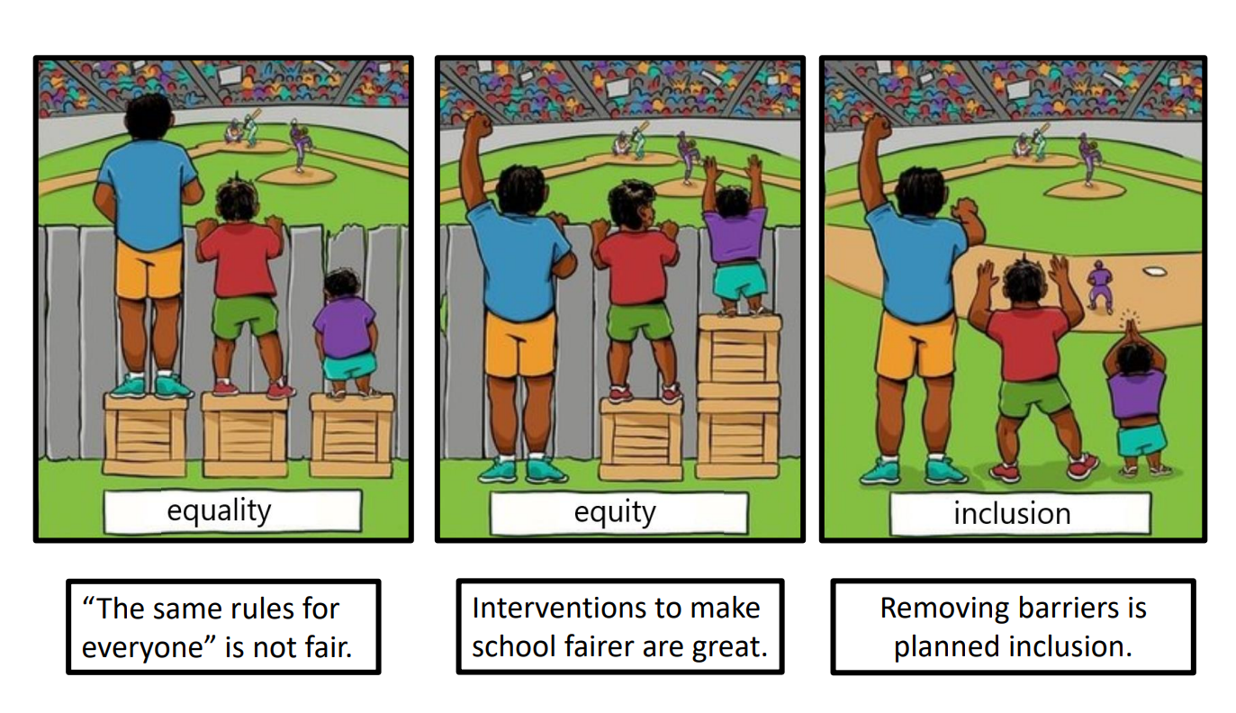
Why are adjustments important?
Notes:
In the first image, you can see that it is assumed that everybody will benefit from the same support. They are all being provided with a crate to see over the fence; they’re being treated equally. But the shorter person in that picture still can’t see the game. This is equality.
In the second image the individuals are given different support based on their height, to make it possible for them to have equal access. So, the shortest person has been given two boxes so they can see over the fence, which seems ok from a fairness perspective. This is equity.
But the third image is where advocacy comes in because we see a complete redesign, a systemic change, where the barrier is replaced with a clear fence so that everybody can see, and the boxes don’t need to be provided at all. This is inclusion.

Slide 12
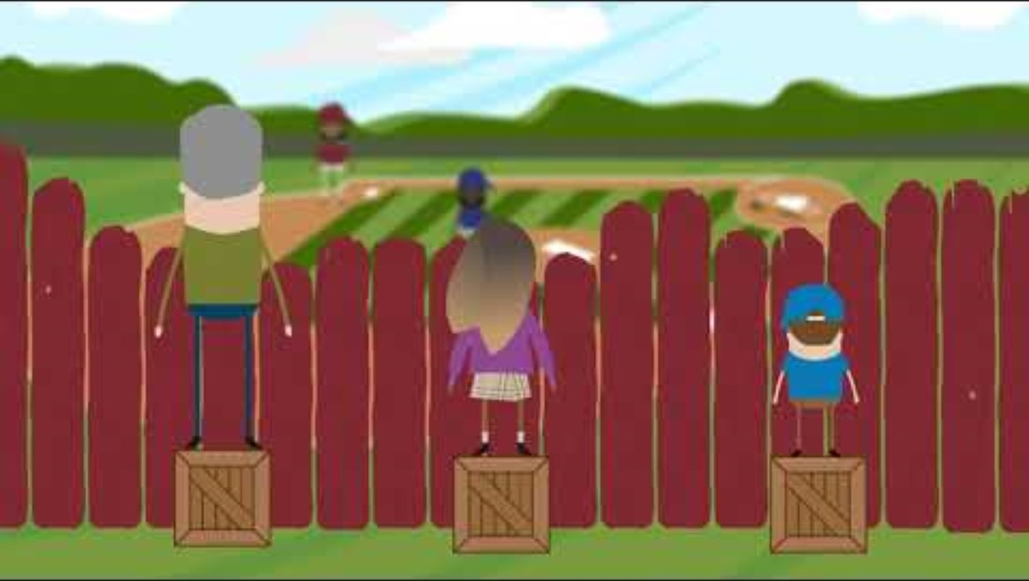
Notes:
Reducing barriers in education and promoting inclusion means creating a learning environment where all students, regardless of their background or abilities, can fully participate and thrive. This involves actively removing obstacles to access, participation, and learning, while valuing diversity and fostering a sense of belonging.
Barriers to education can be both internal (intrinsic) and external (extrinsic) to the student. Intrinsic barriers include learning disabilities, lack of motivation, or cognitive limitations. Extrinsic barriers encompass factors like poverty, lack of resources, cultural or social issues, and emotional distress.
Hearing-roger system, visual cues
Vision-seating arrangements, visuals enlarged, clear pathways, voice to text options, braille devices
Speech-AAC devices-augmentative and alternative communication devices
Wheelchair-ramps, furniture
Anxiety-headphones, fidget tools, providing a structured and predictable classroom environment, offering choices, and breaking down tasks into smaller, manageable steps, therapy dog,
As we support students are we considering what is causing that barrier to be there? How can it be taken away? How will this happen?

Slide 13

Looking at the images, why does the difference between equity, equality and inclusion matter?

Slide 14
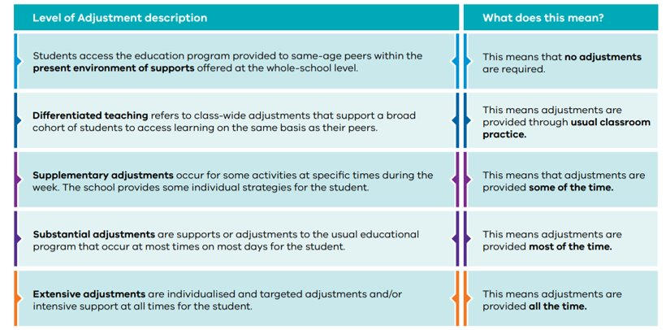
Level of Adjustments
Notes:
So you know what an adjustment is, what they can look like and why we make them, but could all of you distinguish between supplementary and substantial adjustment?​
​
Under DI Reform, it’s really important for school to understand when they are making an adjustment, and what level that adjustment would fall under. It’s also really important to be able to evidence the adjustment.​
​
Adjustments are broken down into five levels, as shown on this slide. The language used is in line with that of the National Consistent Collection of Data on Students with disability, which some of you may be aware of. ​
​
Students who are receiving several adjustments in those higher levels, being substantial and extensive, are generally students with high needs who may be needing individualized funding to support their access and participation at school.​
​
When determining what level an adjustment is sitting at, we consider the intensity (how much effort is needed to do the adjustment), frequency (how often the adjustment is needed) and personalisation (how uncommon the adjustment is) of an adjustment.​

Slide 15



What is an adjustment?
Adjustments are actions taken to enable a student with disability to access and participate in education on the same basis as other students. Adjustments reflect the assessed individual needs of the student. They can be made at the whole-school level, in the classroom and at an individual student level.
Frequency (how often)
Intensity (how much effort)
Personalisation (how uncommon)
Notes:
Adjustments are student specific and school wide modifications that are put in place to enable students to participate in activities on the same basis as their peers across the categories on this slide.

Slide 16
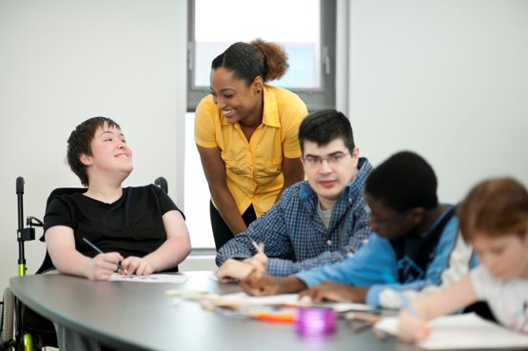
Let’s look at adjustments in more detail.
Adjustments can be made across any or all of the following:
planning
teaching and learning
curriculum
assessment
reporting
extracurricular activities
environment and infrastructure
resources.
Notes:
Adjustments are student specific and school wide modifications that are put in place to enable students to participate in activities on the same basis as their peers across the categories on this slide.
As an example In a school setting adjustments can be made in a range of areas:
Adjustments for Planning may include planning for the use of assistive technology or allowing time in team meetings to collaboratively look at data to identify students who may require specific adjustments and plan and resource accordingly.
In Teaching and Learning it could include planning and the implementation of adjustments, such as intervention groups etc.
For Assessment and Reporting, an example would be the provision of alternative assessment practices and presentation options.
And for the Environment, it could be ramps, building modifications, displays or providing a range of learning spaces in a specific building- pods, It also includes the classroom environment. It could include if there are spaces to support regulation, a range of different seating choices such as wobble stools and cushions, sit and stand desks, slants boards for writing, hearing loop or sound field systems.
Equipment and Resources in the use of sensory equipment and a range of communication

Slide 17
What is an adjustment?
Adjustments may involve a combination of:
Physical Barriers
Consultancy support or Professional learning
Information in different formats
Additional Personnel
Curriculum delivery & Assessment strategies
Technology or Equipment
Services
Brain breaks
Notes:
Adjustments may involve a combination of:
Addressing physical barriers, including modifications, to ensure access to buildings, facilities and services
modifying programs and adapting curriculum delivery and assessment strategies
providing ongoing consultancy support or professional learning and training for staff
Providing specialised technology or computer software or equipment
preparation of study notes or research materials in different formats
Working with services such as sign language interpreters, visiting school teams or specialist support staff
Or providing additional personnel such as tutors or aides for personal care or mobility assistance.

Slide 18
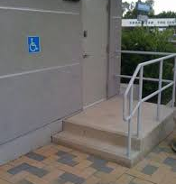
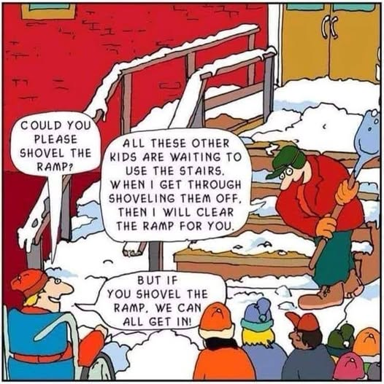
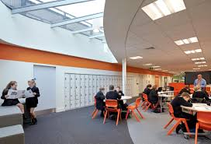
Adjustments to reduce/remove- Physical barriers
Notes:
Having access to the physical learning spaces is essential for all students.
Schools have access to funding through Capital works to ensure that classrooms and bathrooms are accessible for students. This is a reasonable adjustment.
Many schools have open plan learning spaces which are physically accessible by design, however occasionally the acoustics may need adjustment to accommodate students with sensory processing difficulties and students with Autism.

Slide 19
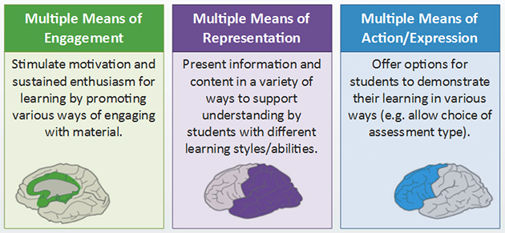
Universal Design for learning
UDL is an approach to designing learning that is accessible for all learners.
It ensures that learners:
have the tools and supports that work for them
have equitable access to learning opportunities
are provided with flexible options rather than a one-size-fits-all approach
are able to adjust the content to suit their learning needs.
Notes:
What is Universal Design for Learning (UDL)?
UDL is a framework to improve and optimize teaching and learning based on what we know about the human brain. Each brain is made of billions of interconnected neurons that form unique pathways. Like fingerprints, no two brains are alike.
Educators face daily challenges in planning for diverse learners. However, learner variability is predictable, and we’ve developed prompts and principles to support educators – the CAST UDL Guidelines.
The CAST UDL Guidelines help educators address the diversity in learning in three main categories:
Engagement (the why of learning): recruiting interest, sustaining effort and persistence, and self-regulation.
Representation (the what of learning): perception, language and symbols, and comprehension.
Action & Expression (the how of learning): physical action, expression and communication, and executive function.

Slide 20
Adjustments to Curriculum delivery
Instructional adjustments: Altering how lessons are delivered, such as using alternative materials like audio loops or visual aids.
Environmental adjustments: Modifying the classroom environment with special equipment, accessible furniture, or different layouts to support learning.
Specialist support: Bringing in occupational therapists, speech therapists, or other specialists for assistance.
Personalised learning approaches: Using strategies like Universal Design for Learning (UDL) to provide multiple ways for students to access, engage with, and demonstrate learning.

Slide 21
Adjustments to Assessment
Alternative assessment methods: Offering options like oral exams, video presentations, or practical demonstrations instead of written tasks.
Flexible timing: Providing extra time for assessments, rest breaks, or extended deadlines.
Assistive technology: Allowing the use of speech recognition software, personal devices, or smart pens.
Support in the assessment environment: Allocating a quiet space, providing a reader and/or writer for exams, or using an audio loop system.
Information formatting: Providing assessment information and materials in accessible formats, such as braille or large print.

Slide 22
Adjustments - Professional learning to build staff capacity
Blended Learning Courses
Supporting Students with Autism
Supporting Students with Oral Language and Learning
Supporting Students with Learning Difficulties
including Dyslexia
Supporting Students with Hearing Loss
Supporting Students with Vision Impairment
Supporting Student Behaviour
Supporting Students with Complex Communication Needs
Supporting Secondary Students with Learning Difficulties
Universal Design for Learning
eLearning modules
Human Rights Approach to Diversity and Inclusion
Supporting Students with Learning Difficulties including Dyscalculia
Notes:
One of the core goals of Disability Inclusion is
To improve whole school approaches and practices and improve teaching practice and the delivery of reasonable adjustments to meet diverse student needs​.
Inclusive Classrooms offer a variety of courses ranging in length from short 3 hr online courses to 5 week and 8 weeks in duration. Blended Learning Courses are a mix of online learning modules/discussions/learning tasks and interactive (face to face or online sessions). These courses are also supported by a trained facilitator. New courses have been written and include Supporting Secondary Students with Learning Difficulties and Universal Design for Learning. We are also currently investigating a course for students with ADHD. SSS with LD will be available in Term 4, 2025.

Slide 23


Master of Inclusive Education and Graduate Certificate Initiative Inclusive Education Scholarships Unit (IESU)
The Master of Inclusive Education and Graduate Certificate in Education (Learning Difficulties) programs connect eligible teachers and regional workforces with fully funded access to postgraduate study in inclusive education.
Made up of 8 evidence-based courses delivered by 7 selected Australian university partners covering learning difficulties (including dyslexia and dyscalculia) and the foundations of learning, literacy and numeracy; inclusive and specialist education; disability and diverse learning needs.
Programs strengthen teachers' capability and confidence, helping schools provide more supportive and inclusive learning environments for all students, regardless of their abilities and backgrounds.
Involving your staff
Consider your school’s professional capabilities and identify gaps in skills and practice
Identify key strategic goals for your school around literacy, numeracy and inclusion – how can more informed staff build greater success?
Review Disability Inclusion (DI) roles at your school and see how they align with the courses available
Encourage staff to visit the master’s and graduate certificate webpages for videos, employment and financial scholarship obligations and application guidelines
Encourage staff to apply between 2 February – 16 March 2026
IESU ARC on-demand videos: check out our Course Information sessions with universities
For videos showcasing how study has impacted graduate teaching practice and schools: visit Disability Inclusion – Inclusive Education in Practice
To find out more or discuss school and staff eligibility, call the IESU on (03) 9084 8496 or email inclusive.ed.scholarships@education.vic.gov.au
Notes:
Discuss as per the slide:
Programs are designed for eligible teachers and regional work forces with a fully funded post graduate study in inclusive education.
Made up of 8 evidence-based courses. Many universities to chose from, based on particular interest.
Strengthens teacher capability and confidence when supporting students.
Things to consider include:
Have you identified any gaps in your staff’s skills and practice?
What are your current school goals around inclusive education?
Do your DI roles align with the courses available?
Visit the websites to find out more.
Apply by the set dates.
ARC-on demand videos – course information available
Impact videos – also attached.

Slide 24
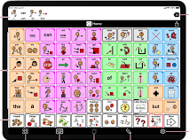

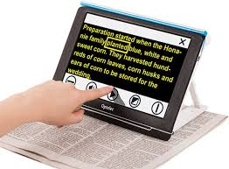




Adjustments - Technology or equipment
Notes:
AAC
Hearing loop system or Roger sound fields
Talk to text programs
Use of sensory tools to support regulation and engagement.

Slide 25
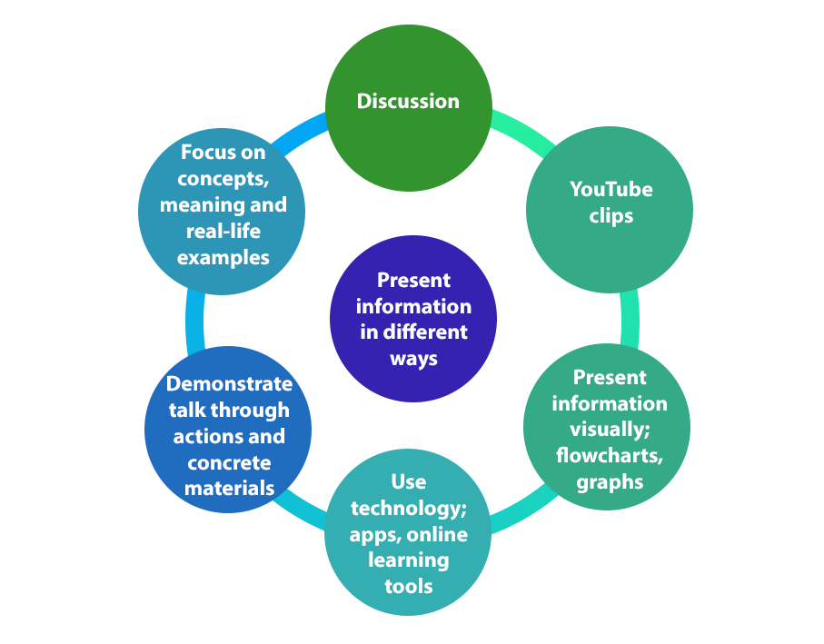
Adjustments – to provide Information in different formats
Offer a range of options
Increase the range of ways students can engage with information. Use two or more learning pathways whenever possible.
When you provide students with written material, talk it through and ensure they understand it. Provide a digital format so they can use a screen reader if necessary.
Notes:
Multiple means of representation

Slide 26
Adjustments – to provide Information in different formats
Often the way material and information is presented can create barriers for students.
What font size, colour, and style works best for you?
What background colour do you prefer for paper handouts or slides?
How much white space on a page or slide helps you focus?
Does an image help your understanding of the task or information?
What other things will support your access, understanding, and attention?
Notes:
As student what works for them.

Slide 27
Adjustments – to provide Information in different formats
Provide opportunities for hands on learning.
Provide a range of opportunities for students to move and physically engage in learning.
Multi-sensory approaches activate different pathways in the brain and make the abstract more concrete.
Multi-sensory approaches are essential for students with dyslexia and neurodiversity and beneficial for all students.

Slide 28
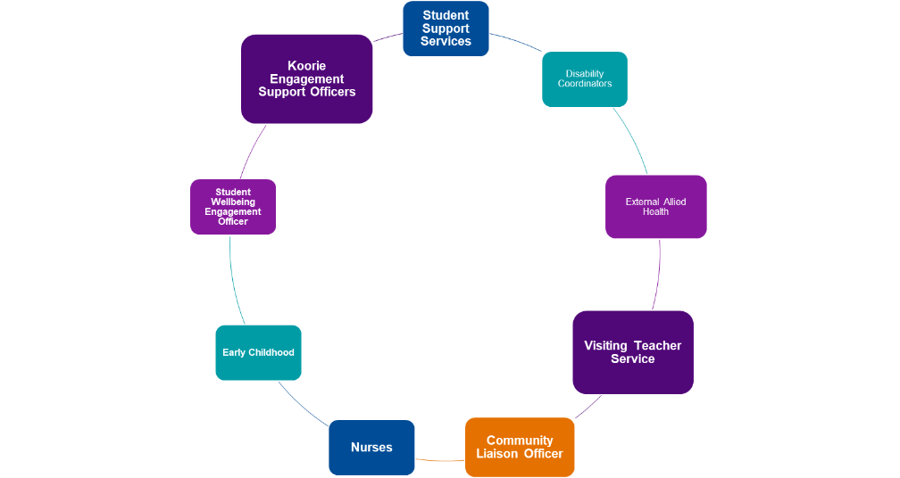
Adjustment- Consultancy support and services
Notes:
All of these workforces that you can see on the slide can be consulted for Specialist Involvement. Allied Health practitioners have extensive expertise that may be sought from schools to recommend what the child or young person requires to achieve success in the school environment. ​
A range of specialists may be consulted by schools- depending on the individual needs of the student- to provide expert guidance and recommendations.​

Slide 29
Adjustment- Consultancy support and services –
Allied Health providers and Specialists
Contribute to discussions about activities within a Disability Inclusion Profile where those activities aligns with their area of expertise.
Recommendations that can be adapted to school environment.
Use strength-based language.
Recommendations that are easily understood and can be referenced in school-based documents.
Allied Health Practitioners can play a range of roles in relation to Disability Inclusion, including:​​
• Individualised supports​​
• Informing or supporting school-wide supports​​
• Capacity and capability building​​
Notes:
In summary, Involvement of Specialists in Disability Inclusion can include:
Contributing to discussions about activities within a Disability Inclusion Profile where those activities align with their area of expertise.
Making recommendations that can be adapted to the school environment and be implemented in the classroom. Key considerations are – what does the child or young person need to achieve success in the classroom and the school environment on the same basis of their peers? It's also important that there is discussion of these recommendations ie, strategies, adjustments etc with the team around the learner ie teachers, coordinators etc
Specialists would also be involved by-
Writing Reports/recommendations using strength-based language.
Making recommendations that are easily understood and can be referenced in school-based documents.
When writing safety plans be sure that you are sending these theough to someone in Leadership and not school email addresses-
Add notes about who safety plans should be sent to in a school
Examples of Strength based goals
Annotated ROSI- provide hand and link

Slide 30
How might a Specialist be involved?
Supporting planning (e.g. SSGs, IEPs, developing plans)
Problem solving and providing advice/ support (including providing direction about where to find solutions)
Direct intervention (if based on a capability building strategy)
Assessment (where appropriate)
Notes:
Specialist can play an important role in student support group meetings. Schools can be very busy places and often they may forget to invite specialists to SSG/s. You can request to attend if parents and carers feel that it may be appropriate. This is a great way to ensure that your recommendations, as the experts, are incorporated as much as possible into classroom and schools practices.
A specialist can be involved by
Supporting planning
Problem solving and providing advice/support (including providing direction about where to find solutions)
Direct intervention (if based on a capability building strategy)
Assessment (where appropriate)- doesn't mean a formalised assessment- can be through observations or with discussions with the teacher
The DI profile encourages health, wellbeing and inclusion workforces who are supporting students, to
work collaboratively,
draw on existing specialist skills and
support schools to implement adjustments.

Slide 31
Additional Personnel in school
What do you think is meant by additional personnel?
Notes:
In the past, many schools adopted a model of integration in which students with disability were frequently supported by a 1:1 education support (ES) staff member. While well-intentioned, this approach often resulted in students with the greatest learning needs being supported by the least qualified person in the classroom.
Research has consistently shown that this model is not the most effective way to support students with disability. In fact, studies indicate that students who received the highest levels of support from ES staff often made less progress than their peers with similar needs who received little or no ES support.
This reliance on near-constant ES support can unintentionally reduce access to quality teaching and limit opportunities for peer interaction. Instead of focusing on developing deep understanding, the support from ES, frequently centres on task completion. Furthermore, there is a growing tendency for ES staff to assume instructional roles without sufficient direction, training, or pedagogical expertise—placing those with the least preparation in positions of greatest responsibility for students with the most complex needs.
Across schools we are now looking at using education support staff more effectively to support student engagement and learning.
Many parents often feel that their child should have access to a one to one staff member at all times. This is not best practice. For that reason, I want to share the evidence of the effective use of ES with you.

Slide 32




1. Deploy Education Support Staff in ways that enable all pupils to access high-quality teaching
ES should supplement – not replace – the teacher. This means that pupils who struggle most should spend at least as much time with the teacher as other pupils, if not more.
"The ES is an assistant to the teacher, not an assistant to the child"​
Assistant Principal from a school in Bairnsdale
Notes:
These recommendations come from the Education Endowment Foundation (EEF), a UK-based study on the impact of teaching assistants.
In the UK study, the term used is teaching assistant, but for the purpose of this professional learning, we will use Education Support Staff (ES).
Recommendation 1: Deploy ES in ways that enable all pupils to access high-quality teaching.
The study found that ES are most effective when they supplement the teacher’s instruction rather than replace it, particularly for pupils who struggle the most.
So, what might this look like in the classroom? For example:
ES staff may circulate the classroom to identify students who need extra help with a specific learning goal. They can then flag these students to the teacher or provide support through effective scaffolding.
They might also supervise activities like peer reading fluency practice, or other tasks where students learn from each other.
It’s important to note that the responsibility for planning lessons and setting appropriate tasks always rests with the teacher, not the ES staff.
Providing opportunities for teachers and ES staff to meet regularly is essential. These meetings allow for planning, preparation, sharing feedback, and discussing students’ learning and progress.

Slide 33

2. Deploy Education Support Staff to scaffold learning and to develop pupils’ independence
Leaders should ensure ES are prepared to engage in scaffolding practices that support pupils’ learning and ability to learn independently. Supporting pupil independence should be a key consideration of ES deployment.
Notes:
Recommendation 2: Deploy ES to scaffold learning and develop pupil independence.
Leaders should ensure ES staff are prepared to use scaffolding practices that support students’ learning and help them become more independent. Supporting pupil independence should be central to how ES are deployed.
ES staff should be equipped with a range of scaffolding strategies suited to the age, subject, and individual needs of the students they work with.
Over time, scaffolds should be gradually removed to promote independent learning, with teachers guiding ES staff in making these decisions.
And just like we heard in the video, it’s important to give students the chance to try tasks on their own before ES staff step in to provide support.

Slide 34

3. Deploy teaching assistants to deliver well-chosen, evidence based, structured interventions where appropriate
The evidence shows that teaching assistants can support pupils effectively through structured interventions. However, these need to be carefully considered, monitored, and linked to the classroom to ensure positive outcomes for pupils.
Notes:
Recommendation 3: Deploy ES to deliver well-chosen, evidence-based, structured interventions where appropriate.
Evidence shows that ES staff can significantly support students when delivering structured interventions. For these interventions to be effective, they must be carefully planned, monitored, and closely linked to classroom learning.
Before deploying ES in this way, leaders should consider the purpose of the intervention and engage with the evidence base.
Key questions to ask include:
Who is the intervention for?
What specific needs are being addressed?
What data supports its use?
What outcomes are expected, and how will progress be monitored?
And finally, do we have the staffing, time, and resources needed for successful implementation?
A strong structured intervention is evidence-based, connected to classroom teaching, and focused on measurable outcomes. For example, reciprocal reading has been shown to effectively develop reading comprehension when implemented consistently and monitored closely.

Slide 35


4. Prepare and train staff around effective Education Support deployment
School leaders should ensure staff are on the same page about the role of the ES and how they can most effectively support pupils. Ensuring teachers and ES are well prepared to work in these roles increases the likelihood that ES deployment can have a positive impact on pupils.
Notes:
Recommendation 4: Prepare and train staff around effective Education Support deployment.
School leaders play a critical role in ensuring that all staff understand the role of ES and how they can most effectively support students. Clear guidance and expectations increase the likelihood of a positive impact on learning.
Ongoing coordination and communication between teachers and ES staff is essential. This includes planning, preparation, and feedback to ensure everyone is clear on their day-to-day roles.
Research from Webster et al. (2016) highlights a common challenge in schools: ‘The vast majority of teachers reported having had no training in relation to managing, organising or working with ES. In many schools, communication between teachers and ES was largely ad hoc… limited opportunities for planning, preparation, and feedback’.
This reinforces the importance of structured support, collaboration, and professional development for both teachers and ES staff to ensure effective deployment and improved outcomes for students

Slide 36

5. Engage all staff in the process of implementing effective Education Support deployment
Effective ES deployment is complex and dependent on a range of factors. School leaders should focus on implementation as they look to embed effective practices.
Notes:
Recommendation 5: Engage all staff in the process of implementing effective Education Support deployment.
Effective ES deployment is complex and depends on multiple factors. School leaders should focus on careful implementation as they work to embed best practices.
Be deliberate about deployment decisions—these should reflect the school’s context and priorities. The way ES staff are deployed should align with the school’s values and vision, particularly its commitment to inclusion and high-quality teaching for all students.
ES staff may undertake a variety of roles, from pastoral support to fostering independence and supporting learning. It’s essential to clearly define their primary and secondary responsibilities and ensure a shared understanding across the school.
Clear role definition also allows ES staff to be trained and prepared for their specific responsibilities, ensuring they can effectively contribute to positive student outcomes.

Slide 37

Additional Personnel

Slide 38

Transitions
Notes:
20 minutes
Bec

Slide 39

Relationships are at the core of positive transition to school experiences.
When families, schools and communities work together in positive and collaborative ways, a child’s capacity to achieve their learning potential is significantly enhanced—and so is their general health, wellbeing, positive outlook and sense of purpose
Notes:
Families know their children better than anybody. Sharing relevant knowledge that they have about their child with ECEC services and schools can help the transition to school. Families who support their children during transition to school, and who have positive relationships with staff, are likely to continue their and their child’s positive engagement with school.

Slide 40
Types of Transitions in the School Setting
Early Childhood Setting to Primary
Primary to Secondary
From one year level to the next
To another school
Consider the impact that these transitions can have on a child with additional needs.
Transitions for Teachers' Section | AllPlay Learn
Notes:
When talking about transitions in the Primary setting, we're referring to the transition from the Early Childhood Setting to the Primary setting, transition from the Primary setting to the Secondary setting, transition from one teacher to another teacher - to one year level to the next, or it could mean transitioning to a new school at any point throughout Primary or Secondary School.
We need to be really mindful and consider the impact that these transitions can have on a student with a disability and how you can make these transitions seamless for that child.
On this slide there is a link to the All Play Learn website which has some excellent resources for helping students with disability transition at all levels of their schooling. They have a great range of resources for schools and parents to access.

Slide 41

The Transition Process of students with a disability and/or diverse learning needs
Best practice programs that help with the transition of students with a disability and/or diverse learning needs:
starting transition planning early
establishing links with the child’s prospective school earlier than usual
using Program Support Groups to bring key adults together to support transition planning
gathering additional information about the child that might need to be assessed and made available to the school
Notes:
Preparation and planning can be even more important for children with disability or developmental delay so that necessary adjustments and supports are in place before they start school.
Creating an inclusive and supportive culture is key to helping every child feel a sense of belonging. A smooth transition builds confidence, supports wellbeing, and helps children engage socially, emotionally, and academically.
For children with a disability or diverse learning needs, best practice transition means:
Starting early – planning begins well in advance.
Being student-centred – tailored to the child’s individual strengths and needs.
Working together – involving you as practitioners, parents/guardians, carers, and the child in the process. This includes opportunities to meet with staff, share important information, and discuss the best ways schools can support the child.
Other important features of strong transition programs include:
Resourcing – making sure there is time and support dedicated to planning.
Clear coordination – a Transition Coordinator helps ensure good communication between practitioners, family, the child’s early learning setting, and the school.
What this might look like for families and their child:
Transition planning begins as soon as the child is enrolled. Term 2 is a good opportunity for parents to investigate school options and once decided, enrol their child.
From Term 3, the child’s kindergarten or early learning centre will begin sharing information with the school to support planning (using the Transition Learning and Development Statement).
A key contact from the school (such as the foundation teacher or Disability Inclusion Leader) may attend a Student Support Group meeting with family practitioners, family members and the early learning setting, and the primary school.
Transition sessions are held in Term 4, with extra sessions if the child needs them. These sessions give children a chance to get to know the school environment and staff. They also give practitioners and families time to ask questions, tour the school, and discuss adjustments that may be helpful before the child starts.
Our goal is to make the transition a positive, reassuring experience for both parents and their child, laying the foundation for success and wellbeing at school.

Slide 42
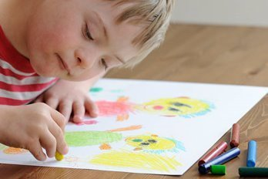
Diverse learners and students with disabilities are considered and supported according to need
When planning transition support, schools should consider the:
nature and presentation of a student’s disability
barriers the student faces to access and participate in the educational setting
adjustments needed to accommodate the student’s individual functional needs.
if there are any key strategies to help children and support their learning and development
what programs have been accessed by the family during the previous year(s)
what additional support might help the child and family with a more successful transition to school.
Notes:
Students with a disability may benefit from transition support being clearly planned over a longer duration, and for schools to recognise the impact that the transition may have on the student, their family, peers and teachers. Students with a disability may have more complex transition requirements beyond adjustments to the curriculum or their immediate environment. Schools need to actively engage students and their families as part of this planning process.
When planning transition support for students with disabilities schools should consider the:
the nature and presentation of a student’s disability
the barriers the student faces to access and participate in the educational setting
adjustments needed to support the student
whether existing transition programs take account of the individual needs of the student and their family
If there are strategies that are known to support the child.

Slide 43
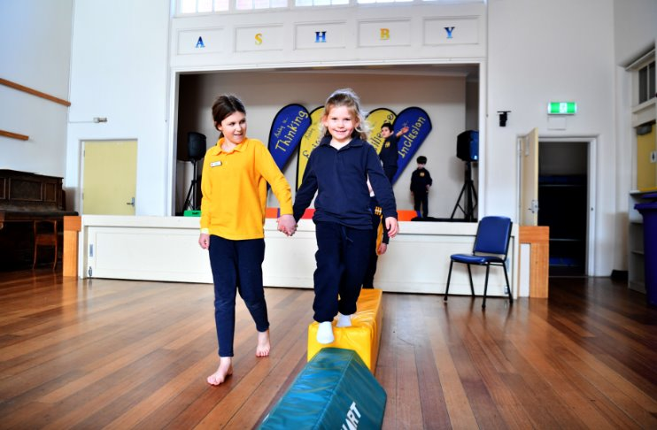

Supporting a child with transition – Early Childhood to Foundation
Key considerations when planning transition sessions might be:
Do activities allow a child who has a physical disability or low or blind vision to join in?
‘
Have we included small groups or pairs for children who become anxious in large groups?
How can we manage noise levels on the day?
Notes:
As you know, starting school is a significant milestone for children and their families. This can involve new routines, new friends, new skills, and longer separations from a parent than a child has had previously. When planning transition sessions, it's important to consider how schools can support students with varying needs. Here are some practical suggestions you may like to consider.
Inclusion of students with physical disabilities or low/blind vision:
Ask, "Do the activities allow full participation for students with physical disabilities or vision impairments?"
Ensure that all activities are accessible, with adaptations if necessary, so that every child can join in meaningfully.
Ensure the student is referred to the Visiting Teacher service who can support the school with the adjustments that will be necessary for a successful transition. Visiting Teachers need a referral through SOCS (Student Online Case System) Future enrolments can access SSS and VTS.
Supporting anxious students:
"Have we included small group or paired activities?"
For students who feel anxious in large groups, smaller settings can help them feel more comfortable and supported.
Older buddies can help ease younger students into the school environment, offering guidance, companionship, and reassurance. This peer support can be especially beneficial for students with additional needs, as it provides a familiar face and promotes a sense of belonging.
Managing noise levels:
"How can we manage noise levels?"
Create quieter spaces or provide noise-reducing strategies for students who may be sensitive to loud environments.
Devices and systems such as Roger Systems or Sound Field systems may be necessary for students with hearing impairment. This can be set up prior to the student commencing. Mention the funding through VSBA.
It is essential to develop a relationship early with the parents and share the transition routines with them so they can talk to their child about possible situations that may be new to them e.g. the bell, transitioning from the classroom to the playground or the playground to the classroom, toileting.
These sessions are also an excellent opportunity to share information with parents. While the child is attending transition the parents can attend information sessions on what the literacy and mathematics programs look like in the school, perhaps a school readiness session, or even have coffee and biscuits and get to know each other.

Slide 44








Books about starting school
The Pigeon HAS to Go to School!
Spot Goes to School
Wombat Goes to School
Starting School
First Day
The Kissing Hand
Starting School
Ozzie Goes to School
Notes:
A great way to get children excited about starting school is by reading them stories about starting school. Many schools can provide their own resources such as social stories about starting school that are specific to their own school.

Slide 45

Managing Transitions and Information Sharing from Primary to Secondary school
Schools are responsible for managing and transferring student information.​
Sharing student information with the next Victorian government school is essential.​
The transition statement provides an overview of the student’s needs.​
It is recommended that a representative from the secondary school attend the final primary SSG meeting.
Notes:
- Schools are responsible for managing and transferring key student information and adjustments during transitions to maintain continuity of support.
- Sharing this information with the next Victorian government school is essential to ensure the student receives appropriate education and support from day one. This includes any key adjustments that were in place at the previous school, such as accommodations for learning, mobility, or communication needs.
- The Transition Statement provides a detailed overview of the student’s needs, support profile, and key adjustments, guiding collaborative discussions during Student Support Group (SSG) meetings.
- For students with disabilities, it's recommended that a representative from the secondary school attend the final Primary school SSG meeting. This helps ensure all critical information and adjustments are communicated effectively, setting the student up for a smooth and supported transition.
For template Transition Statements and further resources and guidance on implementing positive and effective transitions for students with a disability and additional needs, refer to the Resources tab in PAL.
----------------------------------------------------------------------------------
**Transition Learning and Development Statements are completed online via the Online TLDS tool hosted on the Insight Assessment Platform.

Slide 46
Four Phases for Transition from Primary to Secondary School
Preparation phase
spans across Years 5 and 6
aims to prepare students for the transition to secondary school, helping students understand what to expect in secondary school to proactively reduce any anxiety that they may experience.
Transfer phase
Occurs at the end of Year 6, when primary schools share student transition data with the secondary school to support planning and provide targeted support for students.
Coinciding with this phase is the statewide Orientation Day (and any additional transition days).
Induction phase
supports new Year 7 students to develop a strong sense of connection and belonging to their new school and to ease into the new practices, rhythms and relationships of their new school.
Consolidation phase
continues to develop Year 8 students’ sense of connectedness and belonging, building on the skills, knowledge and experiences they have gained in previous phases, with a strong emphasis on supporting their wellbeing and confidence.

Slide 47

School Transition Processes (internal and external)
In school transitions
Formal transition sessions
Extra time with their new teacher in their new classroom
Coming in on a day before school begins
Set aside some time toward the end of the year for hand-over and information sharing.
New primary school
Highlight what doesn't change
Provide visual supports
Consider a buddy system or safe person/space
Invite the student to end of year transition sessions
"Everything you do before, during and after the arrival of the students at your school sends a message that inclusion is important – it helps shift the culture of a school."​
Allira Lang - DI Leader Patterson River Secondary College
Notes:
The idea of moving into a new class with a different teacher and group of peers can be both exciting and challenging for many students and particularly so for students with a disability. It is important that schools help prepare them ahead of time and support them during the transition process.
Here are some things to consider:
Many of the strategies that can help a child transition from an early childhood setting to primary school will also be relevant for transitioning between primary schools, including forming a Student Support Group, creating an Individual Education Plan, encouraging family input and supporting a child with the transition. A child with a disability may feel anxious about the upcoming changes, particularly if the change is occurring part-way through the school year. Moving from one primary school to a new primary school can involve changes to routines and friendships or social groups.
The new school could highlight the similarities between their former school and new school so that they feel confident they already have some of the skills they will need.
Visual supports such as photos of school buildings, maps, photos of teachers and staff, checklists and visual timetables may be helpful for some students.
Peer buddies can provide social support, in addition to a safe person or place that a child can access when they need support.
If the student is coming to you at the start of a school year, invite them to the final transition session so they can get to know their new peers and teacher.
I have included the quote at the bottom because I think it's a great reminder.

Slide 48
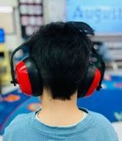
To support a successful transition, schools may want to consider
Time release for Foundation teachers or DI Leaders to meet with families
Making necessary adjustments to the school environment.
Clear signage and easily identifiable staff.
Offering additional school visits and teacher introductions.
Providing Professional Learning for staff
Visuals and colour coding for timetables and material.
Inviting a secondary school representative to attend the final primary school SSG.
REMEMBER to keep a record of adjustments you provide during transition sessions as they contribute to the 10 weeks of adjustments needed for a Disability Inclusion Profile profile) meeting.
Notes:
Students with disability may have complex transition needs. I know schools are already making a lot of adjustments, however some additional things you may want to consider are:
Schools can:
Provide time release for foundation teaching staff and/or DI leaders to visit students in their early learning setting to discuss the student's individual needs and handover transition documentation.
Make adjustments to the school environment prior to the transition sessions, taking into consideration individual student need. For example, students with physical and mobility challenges may experience difficulty because of distances and/or stairs between their classrooms, or a student who is sensitive to noise may find loud activities challenging.
Ensure there is clear signage and easily identifiable staff during orientation sessions to help alleviate anxiety for students and their parents/guardians.
Provide additional opportunities for the student and their families to visit the school and meet their teachers before the start of the school year. This could be as simple as having the student visit briefly during the Professional Learning day at the start of the year when you have time for classroom setup. This would also be important for students transitioning to a new school or year level.
Providing professional learning for school staff to help them understand the unique needs of the student.
Invite the secondary school DI leader to the final SSG for students with disability and discuss and hand over any additional documentation.

Slide 49
Who can help support with the transition?
Early Childhood Education staff | Primary School Staff | Area Staff | School employed specialists | External Specialists
Student Parent/Carer
Early Childhood Educator School based allied health | Foundation teacher Year 6 teacher Classroom teacher Assistant Principal and/or Principal Transition Coordinator School based allied health ES | SSS Visiting Teachers School Nurses Koorie Engagement Support Officers Area based Wellbeing Staff (SWEO/DC etc) LOOKOUT Also, regional-based staff such as a Board Certified Behaviour Analyst (BCBA) | Psychologists Speech Pathologists Social Workers Occupational therapists Mental Health Practitioners Literacy and Numeracy Coaches Teachers specialised in mathematics or literacy intervention through gaining additional qualifications Teachers with a Masters in Inclusive Education. | NDIS therapists Hospital employed Allied Health and Health Professionals, Doctors Allied Health Professionals accessed through Community Organisations such as Headspace Allied health professionals accessed through a mental health plan counsellors eligible for level 3 or above membership of the Australian counselling association accessed through community organisations or hospitals or a mental health plan. DFFH
Notes:
Supporting families and their child through transition requires a team approach.
- …..................This slide highlights key roles and people schools can draw on to help teachers implement supplementary, substantial, or extensive adjustments for transitioning students.
- The Koorie Engagement Workforce can be consulted to build cultural inclusivity in schools and may assist with transitions if necessary.
- Remember, the adjustments you make during transition can be shared with the facilitator service to demonstrate support when a profile is being considered.

Slide 50

Good transition practices matter

Slide 51
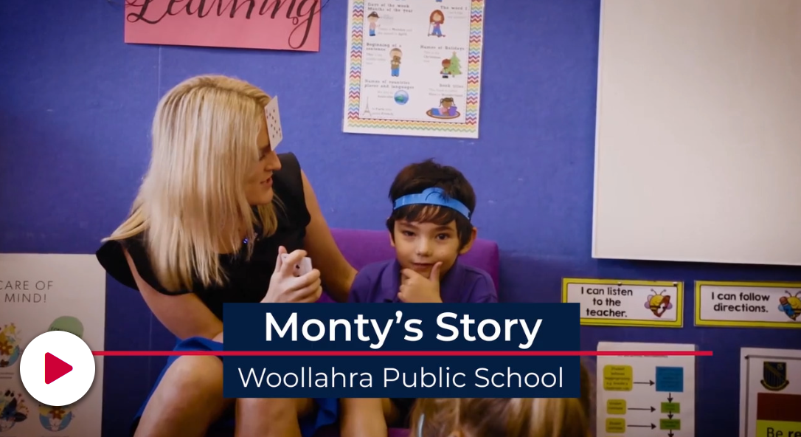
Good transition practices matter
Choosing where your child will learn
Notes:
I just want to share this video as it really highlights the importance of good relationships between parents and school and how planning can make a huge difference in building inclusive practices.
Make sure that I have the video embedded.

Slide 52
Home schooling children.
Home schooling is where parents take on responsibility for teaching their child. It's an alternative to their child going to a school.
Parental responsibility.
All children must go to school or be home schools if they are between 6-17 years of age.
When parents decide to educate their child at home, they take on responsibility for:
Planning their learning
Teaching them
Assessing what they have learnt.
Notes:
Finally, I was asked to give a very brief overview of home schooling and how families can access this alternative.
In Victoria, home education during a child’s compulsory school years is a recognised alternative to attending government or registered non-government schools. The Victorian Government supports parental choice in education and acknowledges that parents/caregivers (parents) who choose to home educate their children do so for a variety of reasons and are willing to commit significant time, energy and resources.
Parents who decide to educate their child from a home base assume overall responsibility for the planning, implementation and assessment of their child’s education. They are also responsible for ensuring the child acquires the knowledge and skills they need for life-long learning, social development and active and informed citizenship.
The Victorian Government recognises that home education can occur across a broad range of styles, from informal learning approaches to formal curriculum programs and, as such, does not mandate curriculum or reading materials. While flexible, it is a requirement of registration in Victoria that a home schooled child receives regular and efficient instruction that, taken as a whole, substantially addresses the eight learning areas
There are certain requirements if parents choose to home school.
Parental responsibility
All children must go to school or be home schooled if they're between 6 and 17 years old.
When parents decide to educate their child at home, they take on responsibility for:
planning their learning
teaching them
assessing what they've learnt.

Slide 53

Who is eligible for home schooling?
Parents residing in Victoria may apply to have their child registered for home schooling if their child is of compulsory school age or if they will turn six in their first year of home schooling. The compulsory school age is 6–17 years.

Slide 54

What constitutes an application for home schooling?
Parents must apply using the Victorian Registration Qualification Authority form Application to Register for Home schooling. Parents must attach details of their child’s proposed program consisting :
A learning plan
The educational materials and resources to be used
Notes:
Parents must submit a learning plan that is appropriate to the educational needs of the child with their application for registration.
A learning plan specifies when and where instruction will take place and the subject matter that will be covered during the first year of registration.
An application for registration must also detail what educational materials and resources parents will use and how their child’s learning outcomes will be recorded. The VRQA provides learning plan templates but their use is optional. A learning plan must be in English.

Slide 55

What is instruction in home schooling?
It is a requirement of registration that a home-schooled child receives regular and efficient instruction that:
taken as a whole, substantially addresses the eight learning areas listed below and
is consistent with the principles and practice of Australian democracy
Parents can design their child’s education program drawing on a range of learning approaches and styles.
Include the following eight learning areas?
English
mathematics
sciences (including physics, chemistry and biology)
humanities and social sciences (including history, geography, economics, business, civics and citizenship)
the arts
languages
health and physical education
information and communication technology and design and technology.

Slide 56
Review of learning.
Victorian Registration and Qualification authority conduct annual reviews to ensure home-schooled children receive regular and effective instruction.
Up to 10% of registered families will be selected each year, with only one child per family reviewed at a time.
Parents will receive written notice outlining the review’s purpose, scope, and timelines. Reviews may explore:
How learning areas are taught
Materials and resources used
When and where instruction occurs
How learning progress is recorded
Parents must provide samples of their child’s work and evidence of progress. Reviews may include a phone or face-to-face interview at a neutral location; home visits are not required.
For more information:
Home school your child | vic.gov.au
Home Schooling and Partial Enrolments : Policy | VIC.GOV.AU | Policy and Advisory Library
Home education | vrqa.vic.gov.au

Slide 57
Where can families get help if needed:
Disability Coordinator inbox email addresses
Bayside Peninsula Area:
sev.bpa.disability.coordinators@education.vic.gov.au
Inner Gippsland Area:
sev.disability.coordinators.iga@education.vic.gov.au
Southern Melbourne Area:
sevr.sma.disabilitycoordinators@education.vic.gov.au
Outer Gippsland Area:
sev.disability.coordinators.oga@education.vic.gov.au
Notes:
There are many different teams within the Education department who are focused on support students with disability. There is a school inclusive practice branch, Disability Inclusion Implementation teams and regional Disability coordinators. If you find that you have any concerns about reluctance to make reasonable adjustments to support students, the place to start would be to contact the Disability Coordinators in your area.

Slide 58
Resources:
All play learn –Home | AllPlay Learn
Latrobe University- Designing reasonable adjustments to support school inclusion - Intended Learning Outcomes
Department of Education Victoria- Reasonable school adjustments for disability | vic.gov.au
Australian Alliance for Inclusive Education - Inclusion Toolkit For Educators - All Means All
Yellow ladybugs- Yellow Ladybugs
I can network - I CAN® - Australia's Largest Autistic-led Organisation
CAST- CAST | Until learning has no limits.
Home school your child | vic.gov.au
Home education | vrqa.vic.gov.au
Home Schooling and Partial Enrolments : Policy | VIC.GOV.AU | Policy and Advisory Library

