Slide 1
NEAMI Noble Park YRRS / YORS

Slide 2
Acknowledgement of country

Slide 3
Introduction
Youth Residential Recovery Services (YRRS) are state-funded community mental health programs that provide accommodation and intensive psychosocial support for up to 12 months to young people aged 16-25 who have significant mental health challenges.
Youth Outreach Recovery Services (YORS) is a supplementary model, introduced in 2021, to provide support to young people aged 16-25 years with mental health challenges pre and post entry to a YRRS and as an alternative to a YRRS placement.
More than housing or outreach support, the YRRS and YORS are spaces to reset foundations, which can have lifelong implications across many aspects of a young person’s life.

Slide 4
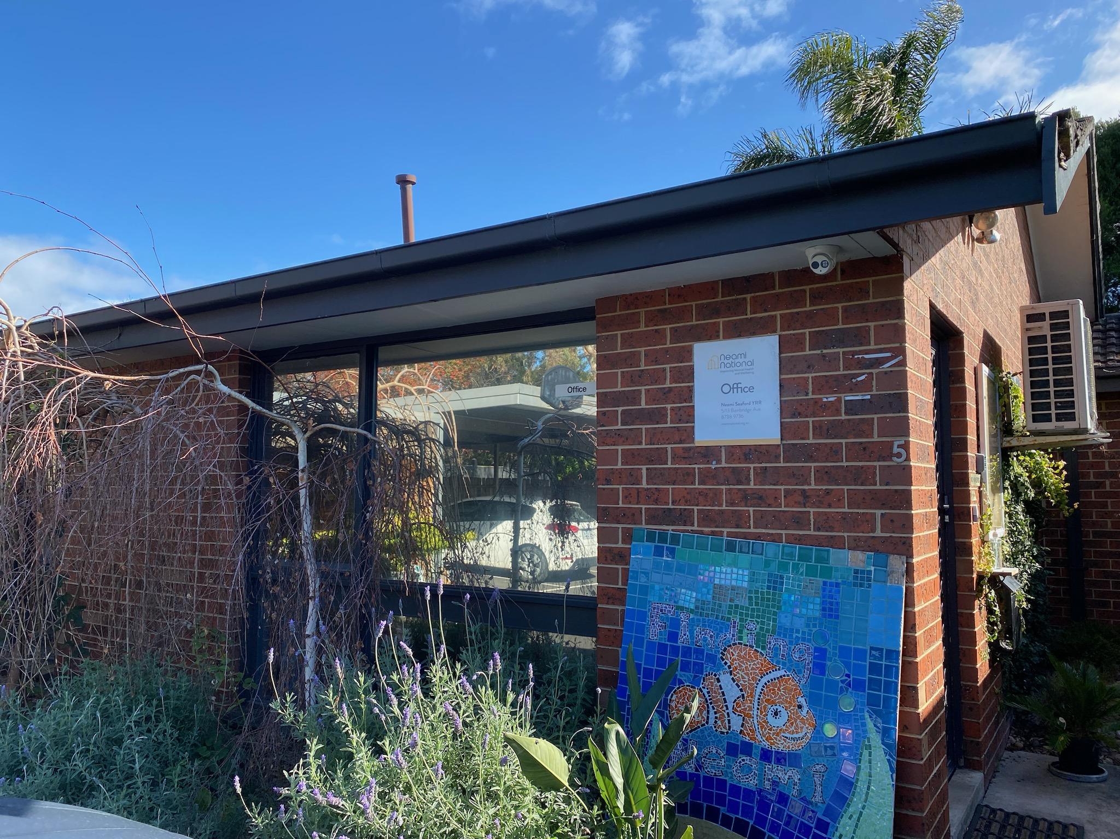

Slide 5
What is Neami Noble Park YRR? Neami National runs Neami YRRS in Noble Park, supporting up to 10 young people at a time. Young people live on site whilst participating in the program for a period of up to 12 months. These young people present with a range of mental health concerns including but not limited to severe anxiety, depression, PTSD, and early psychosis, with many having histories of complex trauma. The accommodation is a cluster of two-bedroom units and shared communal spaces. Support workers deliver strength-focused support through structured group programs and individual support. The structured routine includes morning check-in and a weekday group program collaboratively developed by staff and young people. Weekends regularly feature excursions including bushwalking and shopping.

Slide 6
Group Support The YRRS is a supportive and friendly community providing group programs and weekly meetings with other participants. Group programs are collaboratively designed with young people at the service to make sure they meet the needs of the those present. The focus of group programs are diverse, and may include topics such as boundaries, mindfulness, cooking, budgeting, sexual health, community connections and mental health education. Our group programs aim to help with: * build knowledge * learn new skills * explore health holistically * develop awareness around * mental health issues * set goals.

Slide 7
Individual support Young people also attend twice-weekly individual support sessions with an allocated support worker. During their time in the YRRS, they work on key areas of self-development to support them to feel capable and confident to live a life of self-determined meaning and purpose. Some areas of self-development can include: • Self-responsibility • Understanding behaviours and emotions • Self-care • Enhanced coping skills • Independent living skills. The YRRS program may also assist young people to develop and maintain links with their local community, family, social networks, and support them to pursue educational and vocational opportunities.

Slide 8
Testimonials
“It was like the first time actually being heard, and listened to and, taken seriously” (YOUNG PERSON – YRRS).

Slide 9
What’s important in residential youth mental health care? Trauma-informed care Support is delivered in line with the core principles of safety (including cultural safety), choice, collaboration, trustworthiness, transparency, and empowerment. We believe on the healing potential of belonging, safety, and connection through cultivating communities of real relationships in a homely setting. Attachment theory Early experiences of care have lasting impacts on engagement styles. Young people can develop new relational templates through restorative relationships attuned to their needs. Developmentally appropriate, recovery-oriented care A strengths-based approach to tailoring support in recognition that trauma or other experiences may have impacted a young person’s development relative to their age. A recovery orientation promotes hope, self-belief, agency, identity, and connection. Youth-friendly approaches Participatory approaches which promote self-determination to empower young people as active agents in their care. Care is connected, family-sensitive, holistic, hopeful, and considerate of the personal, systemic, and macro systems in which young people are nested. Young people’s lived experience is considered, and they are supported to use this to inform program design and delivery

Slide 10
Testimonials
“I can’t think of one person who’s come from a safe, supportive home into our service… Every young person that comes in here experiences acceptance and safety and things that they’ve never experienced before... that’s essentially the guts of what happens, that’s the magic that happens here” (STAFF)”.

Slide 11
Eligibility
To be eligible for the YRRS you must:
be aged 16 – 25
be diagnosed with a mental illness
be able to cooperatively engage in a group setting and willing to participate in the program
not use or store illicit substances/drugs or alcohol on site.

Slide 12
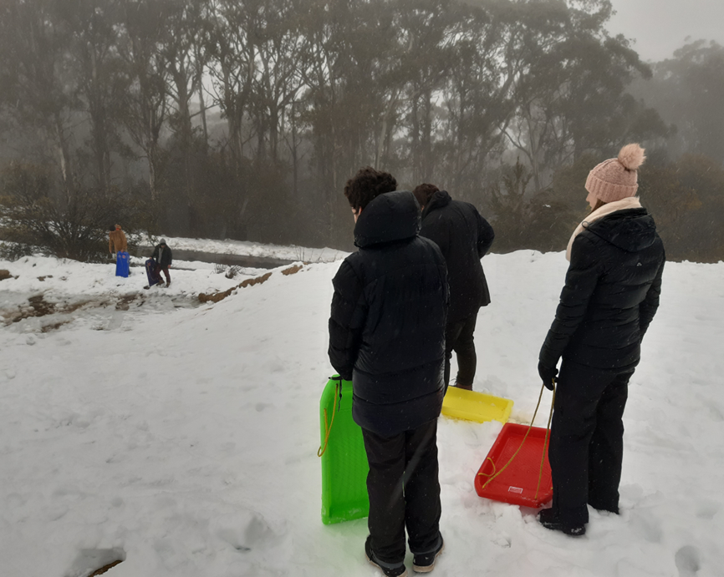
Referrals We welcome referrals from mental health professional or other care providers. Referrals must be discussed with the individual prior to making the referral. Young people can also self- refer to our service and are encouraged to visit our site before deciding to make a referral. Site visit bookings can be made on 1300 001 953, Monday to Friday during business hours. We encourage referrals for people from culturally and linguistically diverse backgrounds, Aboriginal and Torres Strait Islander people, refugees and people who identify as sexually and gender diverse. Referrals can be made on the following details: mhcbbintake@each.com.au (03) 9871 2651

Slide 13
Testimonials
“You’re not going to get yelled at… you just get told “That’s not acceptable,” and actually explain why it’s not acceptable rather than like, “Rah” and just craziness.” (YOUNG PERSON – YRRS)”.

Slide 14
Youth Outreach Recovery Services - YORS
Prior to the introduction of YORS, young people spoke of the significant impact of separating from the relationships and routines that structured the previous 12-months and how more extensive transitional support could have assisted them to vision and enact the next steps of their recovery. A common statement identified by staff from the qualitative exit interviews from the young people was, ‘where to now, feel alone again’. The introduction of the YORS program allows for a softer exit, ‘weaning’ the young person off support as they practice skills, strategies and new founded self-determination developed in the YRR. Young people can consolidate gains and manage challenges in the community with a sense of scaffolding around them as they transition from intense residential support towards independence.
“I’ve got so many tools, it’s up to me now” (YOUNG PERSON – YORS)

Slide 15
Support we offer We work with young people to understand what matters, what will help and how to build the skills to make a meaningful life. Together, either face-to-face or over the phone, we offer support in all the areas that help to improve mental health and wellbeing like: - social relationships and connecting with other people - physical health - substance use - recreation - education - vocational training and employment - housing and other needs. Eligibility To be eligible for the service, you need to be between 16 and 25 and: - live in Victoria - experiencing mental health challenges - your usual coping strategies are not working - you’re noticing signs of anxiety, depression or stress that have lasted more than a few weeks.

Slide 16
Referrals
Referrals are welcome from young people (via self-referral), or from referrers such as carers, schools, youth services, GPs, PARCS, or other services, with consent.
The MHCSS Intake Services will allocate referrals to the closest YORS provider (there is one per area): ACSO, Cohealth, EACH, Mind Australia, Neami National, Uniting, Wellways Australia.
Contact the relevant MHCSS intake team via phone or email, to find out more or make a referral.
North, East, South-East Metro
EACH Intake
(03) 9871 2651
mhcbbintake@each.com.au

