Slide 2
Our school
Foundation College is an independent school which sits within the organisational structure of Foundation Learning Centre.
Foundation College operates independently which is overseen by a school council who reports to the Foundation College Board of Management.
Foundation College is an independent co-educational school.
Two Campuses
Casey: Narre Warren
Peninsula: Frankston

Slide 3
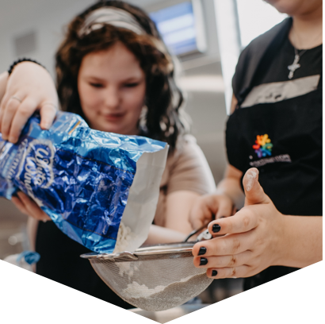
What we offer
VPC
VCE-VM Year 11 & Year 12
YPEP – Young Parent Education Program
3 day on campus program
1 day VET with FLC or external providers
Small class sizes and individual support
Students are supported to develop
employability skills
a high level of interpersonal skills
independent action and decision making skills
leadership skills.
Our alternative education setting encourages students to build their
capacity to engage in education through supportive small classes, access to
Wellbeing and Careers advice, and
curriculum tailored to build their knowledge and skills through real world, hands on learning.

Slide 4
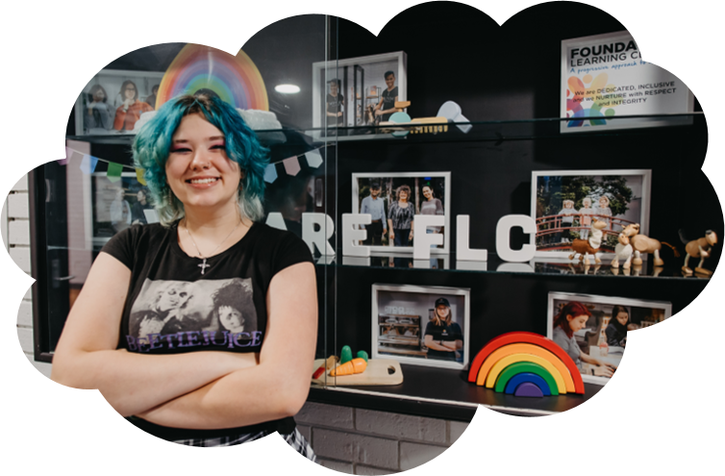
Our Students
have not found success in a mainstream school setting
have disengaged from mainstream education; we support a transition back into education
Wellbeing support
Individualised support in class
Wellbeing sessions
The Resilience Project is team taught with a Wellbeing staff member and Class teacher
Wrap around care linking students with existing support network to ensure each student is well supported and set up for success.

Slide 5
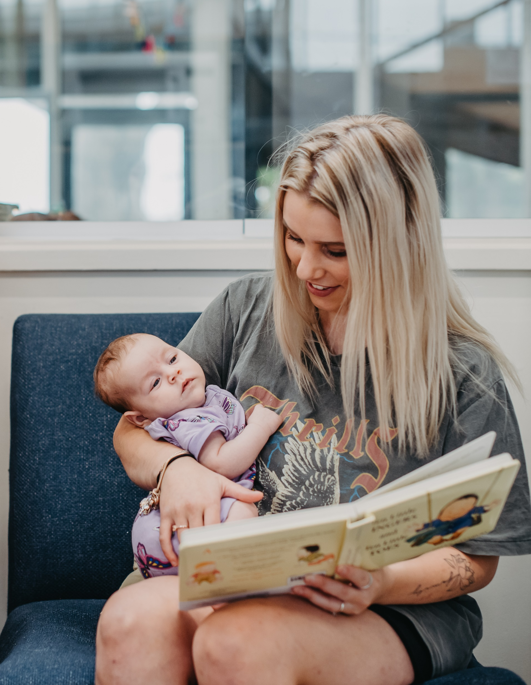
Young Parent Education Program
The YPEP is an inclusive and flexible Learning model for pregnant and parenting young people
Students are encouraged to bring their babies into class whilst studying (until walking or 12 months old at Casey and to 4 years at Peninsula)
A qualified childcare support worker will be in attendance during every class to assist with providing care for the babies and support the students with developing skills and knowledge to care for their baby.
Wellbeing support for young people

Slide 6
Referrals and Eligibility
Majority of referrals are through the Young Mothers Transition Program which assists young mothers to complete education and training. The prospective students attend a tour of YPEP and can meet the teacher, childcare support worker and view the classroom.
Students will then complete the necessary enrolment forms and attend a meeting with our campus leadership team and wellbeing which determines their eligibility for the program.

Slide 7
A Day in the Life at YPEP - Students
Class times – Monday, Tuesday and Thursday 9.00am – 2.30pm
Our day is broken up into 5 periods covering a wide range of subjects (Numeracy, Literacy, Work Related Skills and Personal Development Skills). The students also engage in The Resilience Project once per week with a strong focus on resilience, gratitude, empathy and growth mindset.
Students have the opportunity to participate in incursions and excursions which are linked to the curriculum. These events are held in conjunction with Foundation College so that we build on a community focus towards education.
We prioritise creating a classroom environment where young parents can openly share their experiences, while also receiving valuable advice and support from one another.

Slide 8
A Day in the Life at YPEP - babies
Students arrive to class where Donna will greet the student and their child – there will be a check in of how the baby has slept, if they are due a bottle/feed/breakfast. Donna will then ask the student if they are happy for the baby to move to the baby play area.
Donna focuses on babies’ various developmental areas based on the babies age when planning experiences – gross motor skills (tummy time, sitting, crawling); fine motor skills (grasping); communication (stories and songs).
There is a strong focus on being led by the student as to what their babies' needs are – parents put their babies to sleep with assistance if required. If the student is engaged in work, Donna will offer to feed the baby so that the student has a chance to finish off what they are doing.
Donna offers advice to the students based on the developmental needs of the baby – students are encouraged to ask questions.

Slide 9
Enrolling at Foundation College
Email: contact@foundationcollege.vic.edu.au
Website: www.foundationcollege.vic.edu.au

